Slide 1
The History of Sexual Assault Awareness Month
PROGRAM WITH PURPOSE

Slide 2
Trigger Warning
Today’s program will focus on sexual assault awareness topics including the statistics surrounding populations of survivors and the history of sexual assault prevention and advocacy efforts in the United States. Some of the program may be emotionally and intellectually challenging to engage with. We completely understand that the program may be triggering for some members.
We hope Sexual Assault Awareness Month is a positive education tool for all and it is positively adding to the membership experience and not causing undue harm.
Please feel free to leave the program at any time if needed and utilize the resources shared on the following slide.

Slide 3
Resources
LOCAL RESOURCES
NATIONAL RESOURCES
Facilitator should insert local resources here!
The National Sexual Assault Hotline (RAINN)
hotline.rainn.org
800-656-HOPE

Slide 4
In order to advocate for a better future, we must first understand both our present and our past.

Slide 5
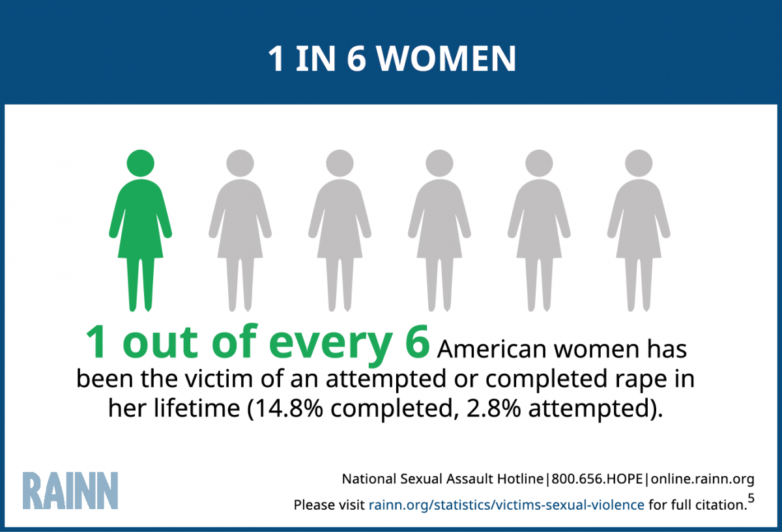
The Present

Slide 6
Sexual assault is not just a women’s issue.
21% of TGQN (transgender, queer, nonconforming) college students have been sexually assaulted, compared to 18% of non-TGQN females and 4% of non-TGQN males.
1 out of every 10 rape victims is male.

Slide 7
The Past
ORIGINS OF SEXUAL ASSAULT PREVENTION AND ADVOCACY IN AMERICAN HISTORY

Slide 8
Did you know?
ROSA PARKS GOT HER START IN ACTIVISM ORGANIZING AGAINST SEXUAL VIOLENCE IN 1944, WELL BEFORE HER FAMOUS BUS BOYCOTT IN 1955.

Slide 9
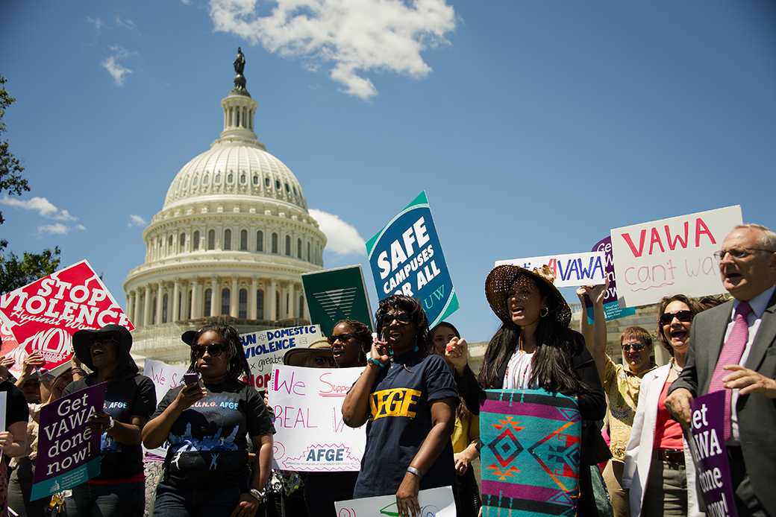
When did the Violence Against Women Act first become law?
1978
1991
1994
2001

Slide 10
Alpha Chi Omega and DVA
Alpha Chi Omega National Council, 1990-92

Slide 11
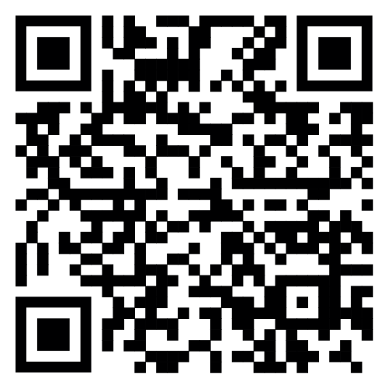
The Creation of SAAM
Created by the National Sexual Violence Resource Center (NSVRC) in 2001
Color: Teal
Symbol: Ribbon
Month: April
Two goals: Awareness and Prevention
Learn more about the history of SAAM from the NSVRC here:

Slide 12
What will you do?
YOUR COMMITMENT TO SUPPORTING SURVIVORS, EDUCATING OTHERS AND TAKING ACTION TO END SEXUAL VIOLENCE IN OUR COMMUNITY

Slide 13
Thank you!
Be sure to complete the Programs with Purpose feedback survey!
SURVEYMONKEY.COM/S/D9BSHRS

