Slide 1


Send with Love
PROGRAM WITH PURPOSE
Notes:
Instructions: Facilitator should introduce herself and her connection to the topic. Generally, setting a positive tone for the program.
Facilitator: Before we begin, I want to take a moment to share that throughout this program, we will be discussing signs of healthy and unhealthy relationships. If this is a challenging topic for you, please feel welcome to leave the room at any time. I want you to do what is best for you!

Slide 2
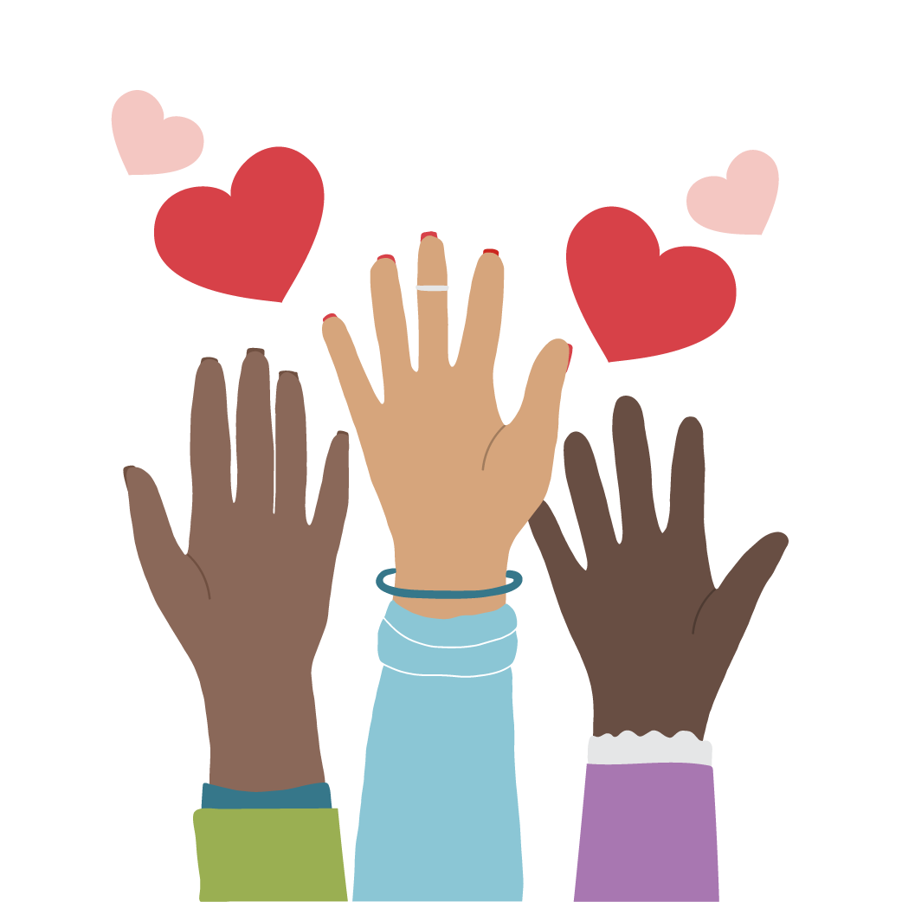

Without judgement, raise your hand if you have ever texted someone more than five times in a row?
Notes:
Facilitator: Without judgement, raise your hand if you have ever texted someone more than five times in a row? Could have been to a friend, parent, partner, whoever!
Many of us have been guilty of it, right? And in some contexts, it’s entirely appropriate, whether we’re sending a stream of rants to a friend about a test gone wrong, or maybe it’s in the context of sharing plans for the night! In other contexts, a stream of five texts can be seen as intense … maybe even a little territorial, depending on who it is from and their intentions with sending.
Today, we’re going to think about and decipher healthy and unhealthy behaviors digitally.

Slide 3

Notes:
Facilitator: Has anyone heard of the One Love Foundation?
The One Love Foundation is a national nonprofit that educates individuals on relationship abuse and empowers people with the tools and resources to see the signs of healthy and unhealthy relationships.

Slide 4
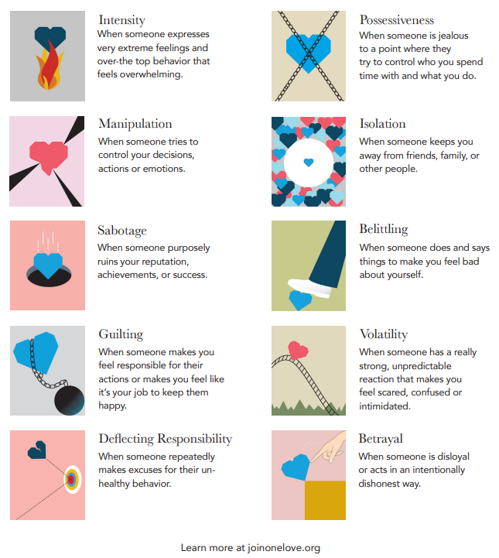

10 Signs of Unhealthy Relationships
Tip: Take a photo of this slide to reference later!
Notes:
Facilitator: They share the 10 signs of healthy and unhealthy digital relationships. Unhealthy signs include:
Intensity. This may be when someone expresses very extreme feelings and over-the-top behavior that feels overwhelming.
Manipulation. Which is when someone tries to control your decisions, actions or emotions.
Sabotage. This could be someone trying to purposely ruin your reputation, achievements or success.
Guilting. Which is when someone makes you feel responsible for their actions or makes you feel like it’s your job to keep them happy.
Deflecting responsibility. This is when someone repeatedly makes excuses for their unhealthy behavior.
Possessiveness. This happens when someone is jealous to a point where they try to control you, who you spend time with and what you do.
Isolation. Which is when someone keeps you away from friends and family.
Belittling. When someone does and says things to you to make you feel bad about yourself.
Volatility. This is when someone has a really strong, unpredictable reaction that makes you feel scared, confused or intimidated.
Betrayal. Which is our last of the 10 unhealthy signs. This is when someone is disloyal or acts in an intentionally dishonest way.
Did any of these signs stand out to you?
There may even be signs on here that you have realized you are guilty of. 100% of us do unhealthy things – that is OK. We can all recognize our unhealthy behaviors, prevent them from becoming patterns and respond with healthier behaviors in the future. The other important thing to note is that there is a difference between emotions and behaviors. You will notice that emotions like jealousy or anger aren’t on this list. That is because it is normal to feel those things, but important to understand how they are expressed. Does jealousy turn into possessiveness, or are you able to use that emotion to calmly start a conversation about trust in the relationship?

Slide 5
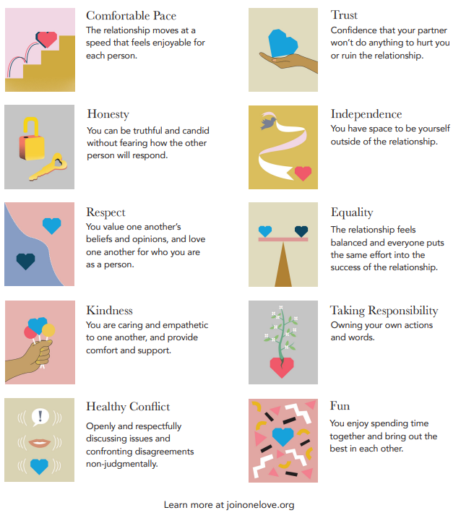
10 Signs of Healthy Relationships
Tip: Take a photo of this slide to reference later!
Notes:
Facilitator: We’ve recapped the unhealthy signs, so now it’s time to learn the healthy signs! These include:
Comfortable pace. This is when a relationship moves at a speed that feels enjoyable for each person.
Trust. Which is confidence that your partner won’t do anything to hurt you or ruin the relationship.
Respect. You value one another’s beliefs and opinions and love one another for who you are as a person.
Fun. This is as simple as enjoying spending time together and bringing out the best in each other.
Healthy conflict. This occurs when you feel open and can respectfully discuss issues or disagreements in a non-judgmental way.
Honesty. This is being truthful and candid without fear of how the other person will respond.
Independence. You have space to be yourself outside of this relationship.
Equality. This is when the relationship feels balanced. Each person puts the same effort into the relationship.
Taking responsibility. This happens when you own your actions or words.
Kindness. This is being caring and empathetic to one another and providing comfort and support.
Is there a healthy sign you want to incorporate more into your life and friendships or relationships?
I think there are always healthy signs we can work to better incorporate into our lives and relationships. Thanks, everyone, for sharing!

Slide 6

Sent with Love?
ACTIVITY
Notes:
Facilitator: Now that we’ve properly familiarized ourselves with the healthy and unhealthy relationship behaviors, we’re going to do an activity. On the screen, you will see a text exchange. You are going to decide if it’s healthy, unhealthy or needs clarification. Are you ready?!

Slide 7
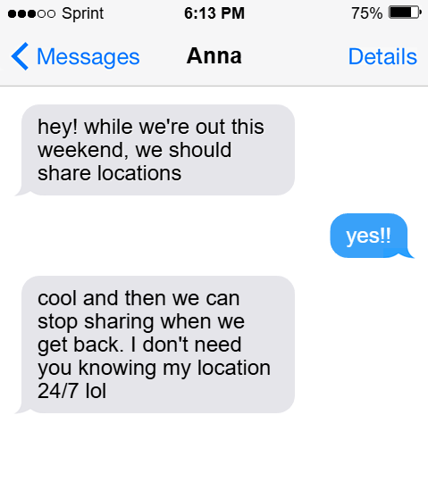


Healthy or Unhealthy?
Notes:
Instructions: Facilitator can read the text exchange or have members read the text exchange aloud.
Give me a thumbs up if you believe this is healthy and a thumbs down if you believe this is unhealthy.

Slide 8

Notes:
Facilitator: This text exchange is … healthy!
Anna texted seeking permission to share locations while they were going out. While she did make a joke after, the act of checking in with someone before requesting their location and/or sharing yours is a sign of respect and mutual understanding.

Slide 9
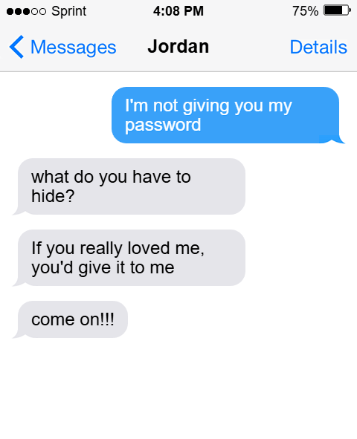
Healthy or Unhealthy?
Notes:
Instructions: Facilitator can read the text exchange or have members read the text exchange aloud.
Give me a thumbs up if you believe this is healthy and a thumbs down if you believe this is unhealthy.

Slide 10

Notes:
Facilitator: This is … unhealthy. In these texts, Jordan is trying to guilt their partner into sharing passwords.

Slide 11
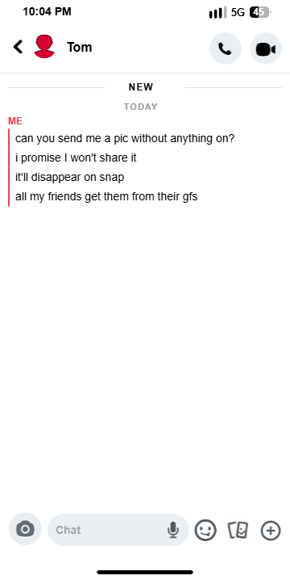
Healthy or Unhealthy?
Notes:
Instructions: Facilitator can read the text exchange or have a member read the messages aloud.
Give me a thumbs up if you believe this is healthy and a thumbs down if you believe this is unhealthy.

Slide 12
Notes:
Facilitator: If you said unhealthy, you’d be correct! Again, there is guilting in these messages. Depending on the progression of the conversation, there are even potential signs of manipulation.

Slide 13
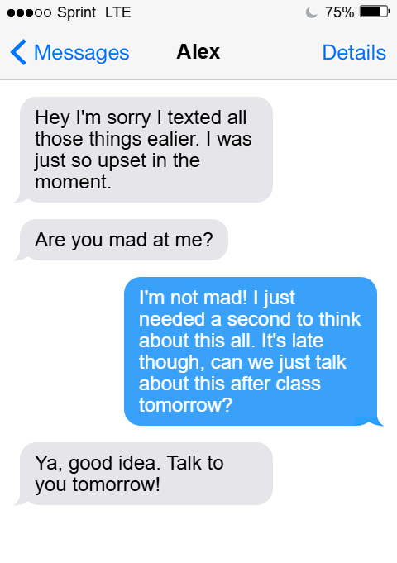
Healthy or Unhealthy?
Notes:
Instructions: Facilitator can read the text exchange or have members read the text exchange aloud.
Give me a thumbs up if you believe this is healthy and a thumbs down if you believe this is unhealthy.

Slide 14
Notes:
Facilitator: This is … healthy! First, we see an apology, with a follow-up to ask if the other person is “mad” at them. After the other person shares that they need some space and asks to talk tomorrow, the first person agrees to talk it through the next day. This a good display of healthy confrontation! They have an unresolved issue and have addressed feelings and a plan to further discuss.

Slide 15
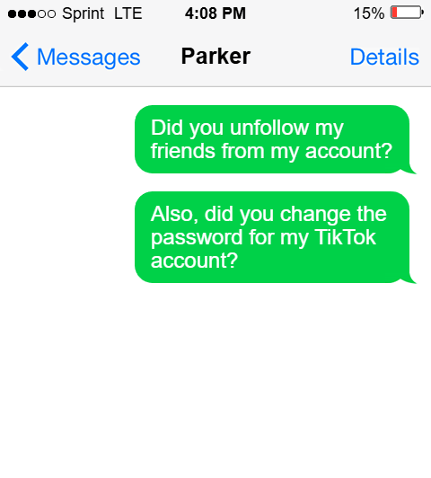
Healthy or Unhealthy?
Notes:
Instructions: Facilitator can read the texts or have a member read the text aloud.
Give me a thumbs up if you believe this is healthy and a thumbs down if you believe this is unhealthy.

Slide 16
Notes:
Facilitator: This is … unhealthy. This individual clearly has passwords to the other’s social accounts, and it’s unclear if those were given out freely or stolen from the other. Even if the partner had given their password(s) freely, the other is still utilizing their social media in a way that has raised questions and potentially concerns.

Slide 17
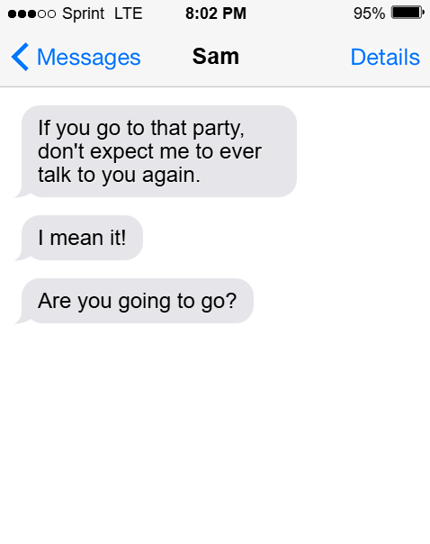
Healthy or Unhealthy?
Notes:
Instructions: Facilitator can read the texts or have a member read the texts aloud.
Give me a thumbs up if you believe this is healthy and a thumbs down if you believe this is unhealthy.

Slide 18
Notes:
Facilitator: This is … unhealthy. In these texts we see control, possessiveness and potentially some early signs of isolation.

Slide 19
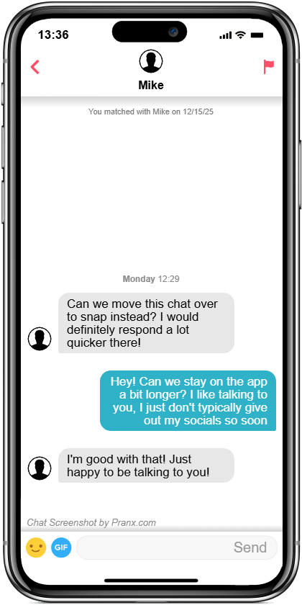
Healthy or Unhealthy?
Notes:
Instructions: Facilitator can read the text exchange or have members read the text exchange aloud.
Give me a thumbs up if you believe this is healthy and a thumbs down if you believe this is unhealthy.

Slide 20
Notes:
Facilitator: This is … healthy! This exchange shows respect, with both people involved moving at a pace that is comfortable with them.
Thank members for participating.

Slide 21

What influences our perception of healthy and unhealthy relationship behaviors?
Notes:
Facilitator: What influences our perception of healthy and unhealthy relationship behaviors?
Answers could include:
Social media
TV/movies
Pop culture/celebrities
Family/parents
Friends
Cultural norms and/or beliefs
Personal morals
Facilitator should allow approximately 5 minutes for members to share and discuss. You can even ask for examples if you need help prompting the conversation forward.

Slide 22


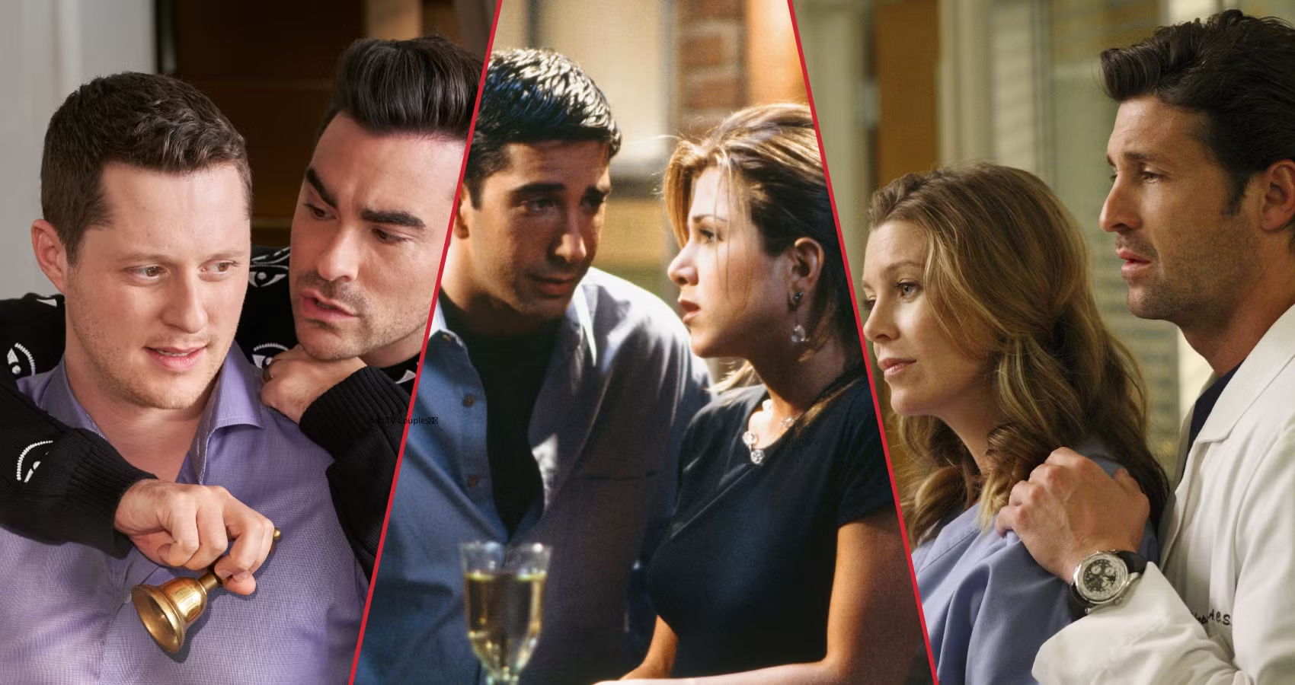


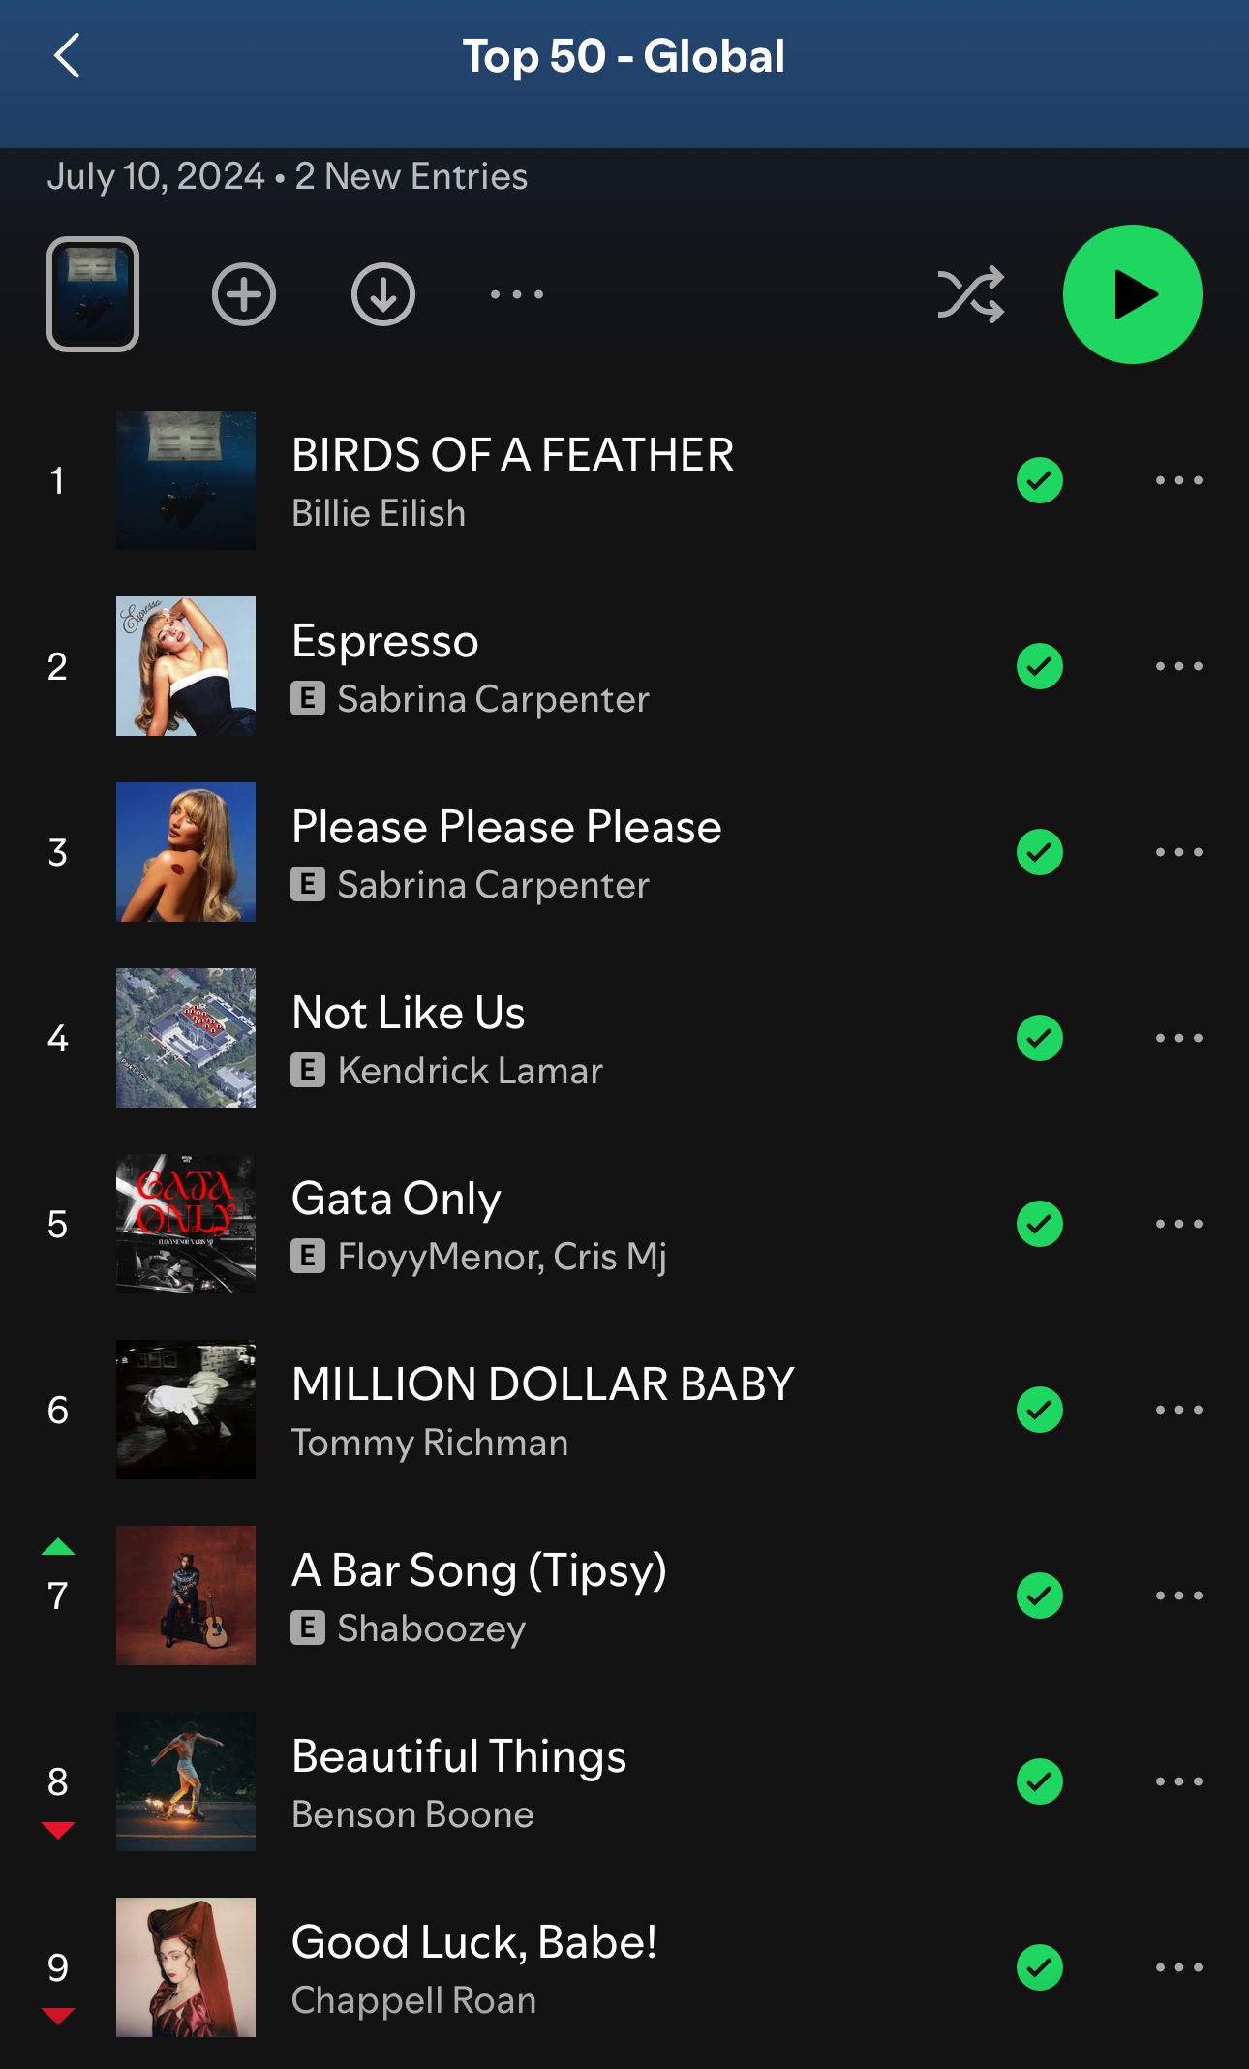



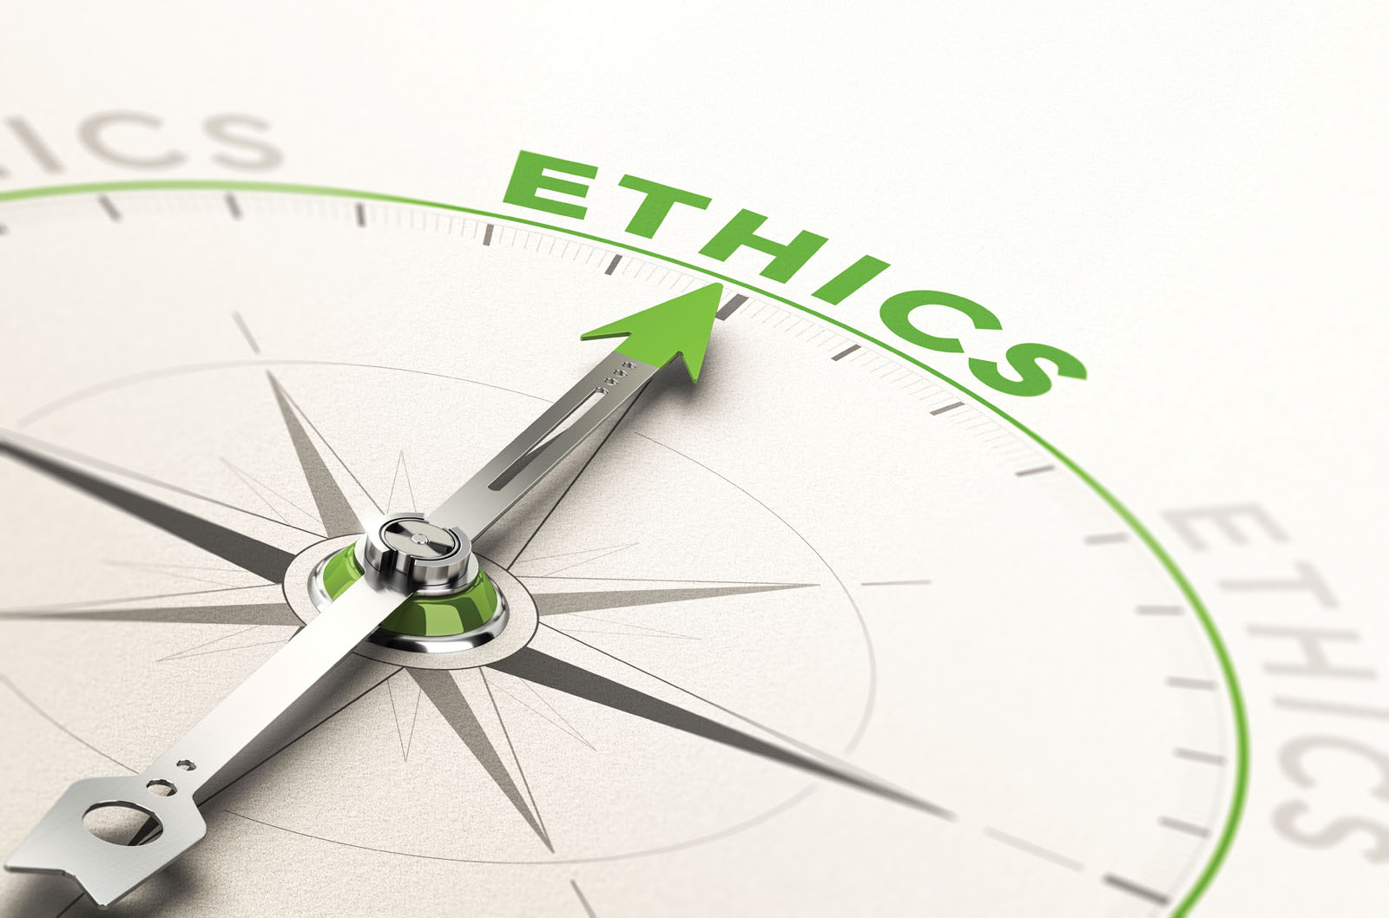
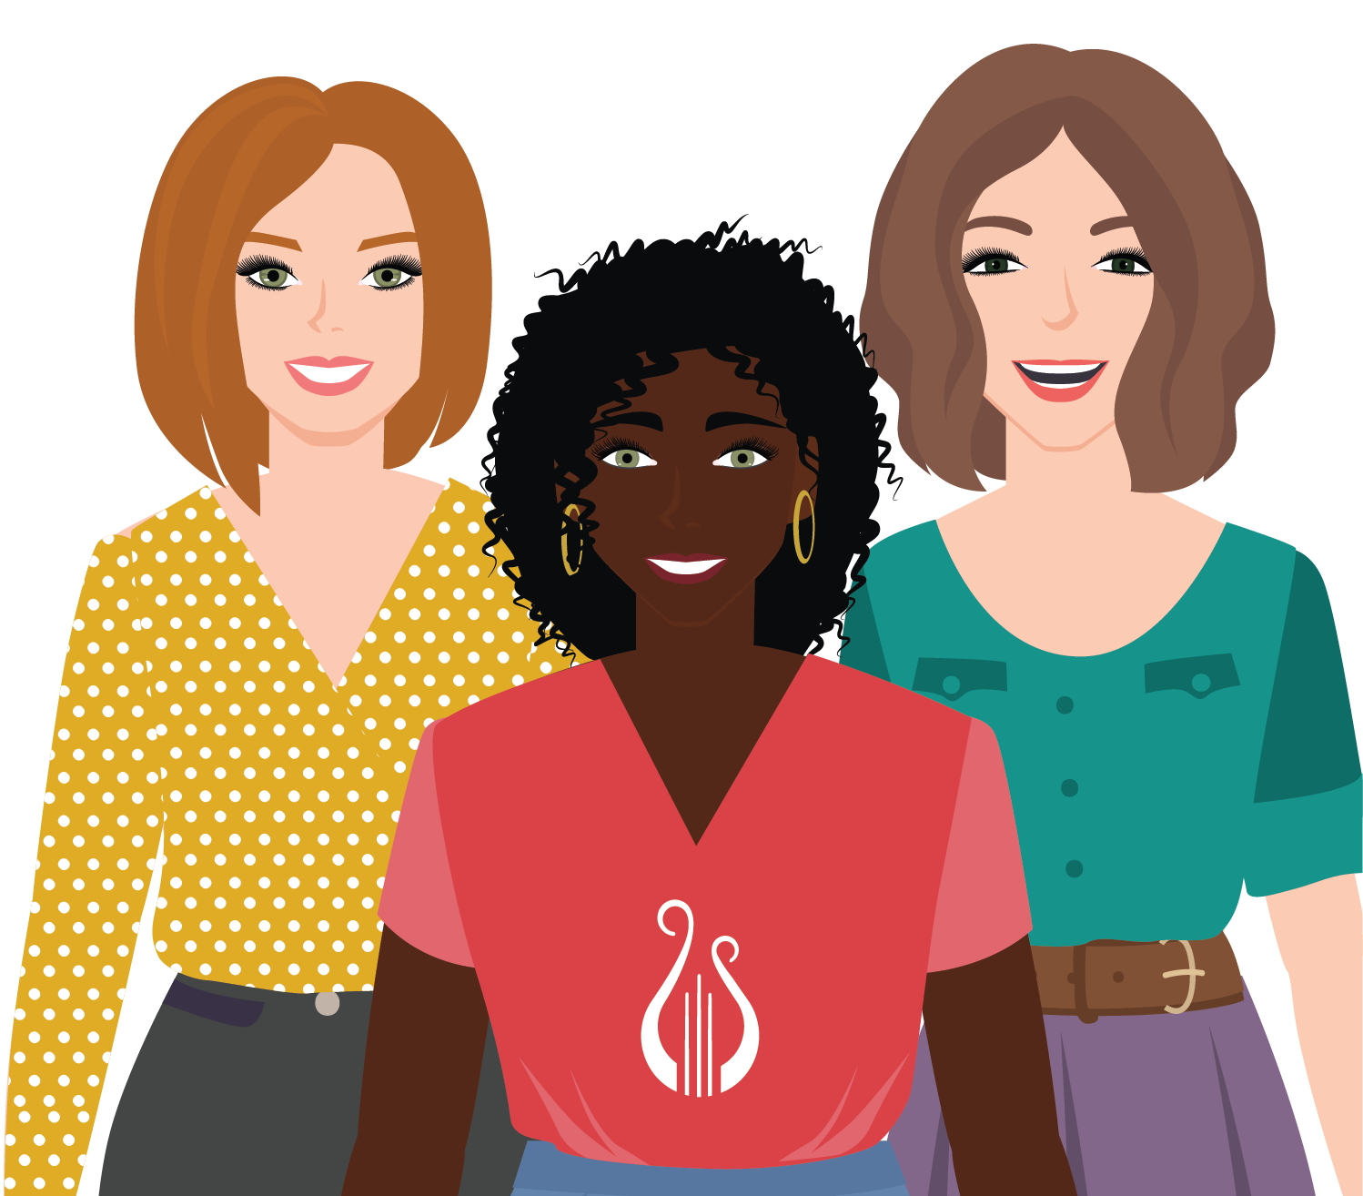
Notes:
Facilitator: Thank you so much for jumping into that discussion! The influences we talked about—family, culture, media, past experiences—can all shape our interpretation of what’s healthy versus unhealthy in our friendships and relationships. And just to be clear, I’m not suggesting you swear off every TV show or movie with a messy couple or messy relationship. The goal is to simply build awareness. When you notice those “red flag” moments on screen or in music, it can become easier to recognize similar patterns in real life.

Slide 23


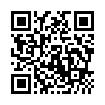
The Hotline
thehotline.org | 800-799-SAFE (7233) | Text “Start” to 88788
love is respect
loveisrespect.org | 866-331-9474 | Text “LOVEIS” to 22522
One Love
joinonelove.org
SHARE PROGRAM FEEDBACK!
Notes:
Facilitator: Understanding the signs of healthy and unhealthy relationships is powerful. When you leave today, I hope you feel you have both the tools to recognize healthy or unhealthy signs in your relationships and the awareness to question the messages that try to define them for you.
On the left side of the screen, you’ll find resources. I encourage you to snap a photo or save these numbers, should you or a friend ever need to utilize them. The QR code on the right will take you to a quick survey where you can share feedback about this program.
Thank you all for participating and helping to bring awareness and celebrate healthy relationships!

