Slide 1
A Guide to BYOB Events
adapted from Zeta Tau Alpha Fraternity

Slide 2
BYOB: BE YOUR OWN BARTENDER
(Or…AKA…Bring YOUR Own Beverage)
Here is how members and guests over 21 actually BYOB.

Slide 3
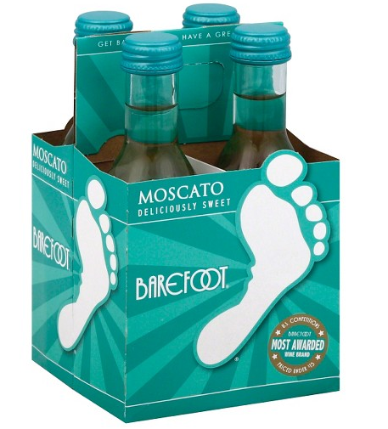
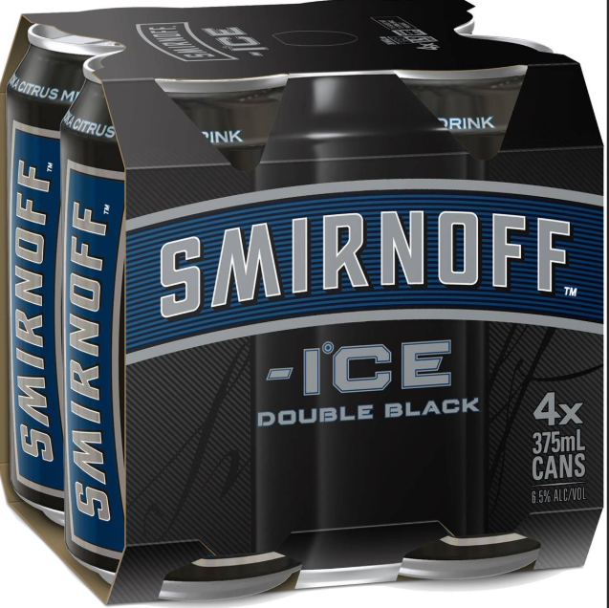
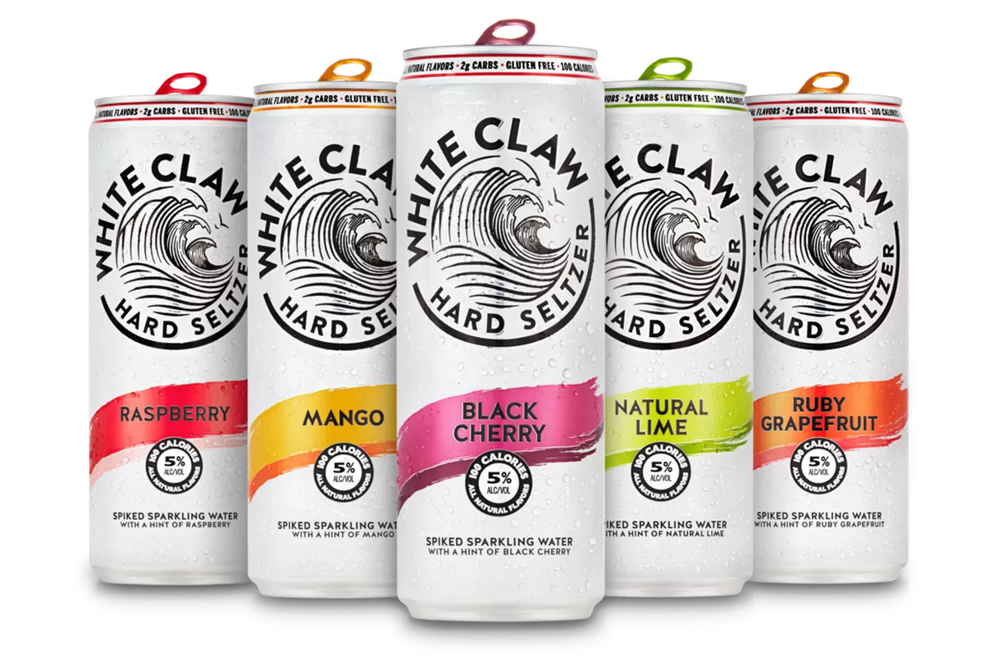
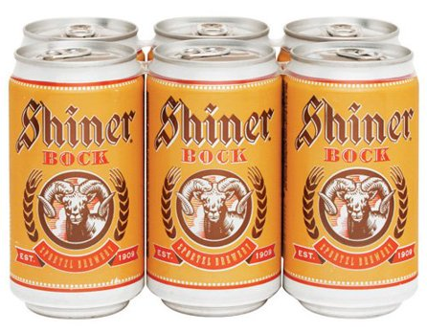
What’s allowed?
Beer, Hard Seltzer, Wine or Premium Malt Beverages
Single serving sizes only
Canned or plastic beverages are recommended. Anything in glass bottles should be poured into plastic cups.

Slide 4
What’s not allowed?
Hard liquor or any beverage over 15% alcohol beverage volume (ABV)
Any alcohol for members or guests under 21

Slide 5
Before the event
Determine a location members and guests will meet to check-in
Have event monitors or executive board officers coordinating check-in
Bags, purses, large pockets will be checked
Members under 21:
Check in at designated location
Members over 21:
Beverages should be in a bag with your name on it, clearly marked
Check IDs and issue a wristband

Slide 6
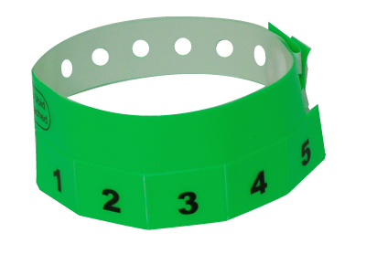
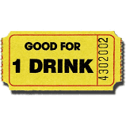
Checking in alcohol at the venue
For every event, determine how the individuals’ alcoholic drinks will be identified (this includes members AND guests)
TICKET SYSTEM
Each guest is given one ticket per drink
The tickets are personalized with the type of drink the guest brought [e.g. Bud Light, White Claw, Lime-A-Rita, Naturdays, etc.]
The name of the attendee is written on their tickets
The guest’s drinks are checked in at the bar by an event monitor who is working the social event
The guest redeems tickets [one at a time] for their drinks at the bar
An empty can and ticket is required for their next drink
WRISTBAND
The individual’s name, type and number of drinks is written on each the wristband with a permanent marker
The guest’s drinks are checked in at the bar by a member who is working the social event.
Each time a guest redeems a drink, an X is added to the wristband
An empty can is required for next drink
NOTE: some wristbands have pre-set “pull tabs” which many chapter’s have found to make this process much easier

Slide 7
During the Event
Designate an event monitor(s) to work the bar area and distribute alcohol
Anyone who wishes to acquire an alcoholic beverage they brought to the event must show their wristband and give and return an empty can if this is not the first request (returning the cans assists the chapter with its recycling efforts and helps ensure that alcohol is not being given away to others once it leaves the service center).
No beverages should be distributed to anyone but the owner who brought it
Leftover alcohol should be discarded or made available for pick up the next day
Only bring what you plan on drinking. Alcohol not consumed during the event needs to be discarded or made available for pick up the next day.

Slide 8
During the Event Food and non-alcoholic beverages
The chapter should provide an amount of non-alcoholic beverages at least equal to the total number of people in attendance at the event.
Breads, meats, cheeses, vegetables, cookies, subs, pizza, brownies, fruits and dips are considered appropriate foods. The chapters should avoid salty foods.
All food and non-alcoholic beverages should be free to all attendees.
Food and non-alcoholic beverages should be contained within one centralized location.
Non-alcoholic beverages should be served from closed containers.
During the last hour of an event, alcohol service should stop; a new non-alcoholic beverage and food item should be served for those who wish to switch beverages and begin winding down.

Slide 9
Risk Reduction and Consequences
If you show up visibly intoxicated: you will be turned away
If you or your date show up with a flask or type of alcohol not allowed: it will be taken & thrown away
If you try to drink on any form of transportation: You will be sent home upon arrival
If you or your date become visibly intoxicated or become ill from over consumption at the event: you will be sent home by an Uber or taxi; paid for by you
All actions that violate our event policies will result in a standards meeting.

Slide 10
Tips and Reminders
Members over 21: only bring what you will drink!
Use a buddy system to help hold members accountable.
look out and take care of each other
You are responsible for your date’s behavior.
Make water and food available for attendees!

Slide 11
Questions?

